Slide 1

Food Deserts & Food environments
Mary Bellavia, David Fournie,
Janelle Goddard, and Eric Evans
Notes:
ERIC

Slide 2
“Unfortunately, food deserts are not few and far between, it’s estimated there are more than 23 million people, more than half of them low-income, living in food deserts.”
Moveforhunger.org
Notes:
ERIC

Slide 3
Questions
What are the demographics for food deserts in Missouri by county?
What is the relationship between the poverty rate for a given county in Missouri and low access populations?
What is the food environment for the counties that comprise Missouri’s two largest cities, St. Louis and Kansas City?
Notes:
ERIC

Slide 4
Definition of Terms
What is a food desert?
“[A] food desert [is] a low-income census tract where a substantial number or share of residents has low access to a supermarket or large grocery store.”
What does low access mean?
“[Living] more than 1 mile from a supermarket or large grocery store in urban areas and as more than 10 miles from a supermarket or large grocery store in rural areas.”
How is low income determined?
“[T]he poverty rate for that tract is at least 20 percent”
How is the poverty rate determined? :
“[A] family's total income is less than the family's threshold, then that family and every individual in it is considered in poverty”
definitions from the United States Department of Agriculture Economic Research Service and Census Bureau
Notes:
ERIC

Slide 5
Demographics ANALYSIS
Notes:
MARY

Slide 6
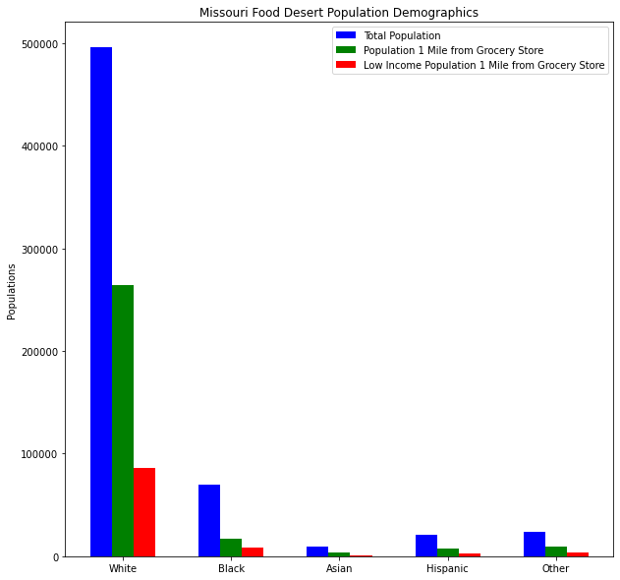
Notes:
MARY

Slide 7
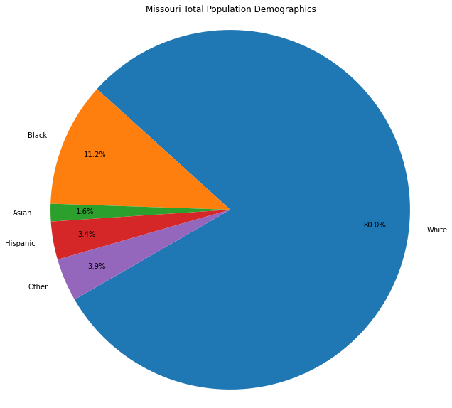
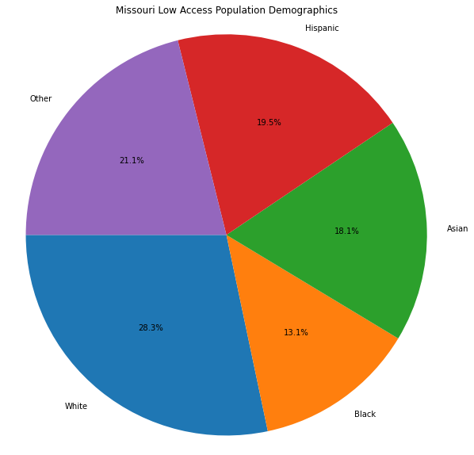
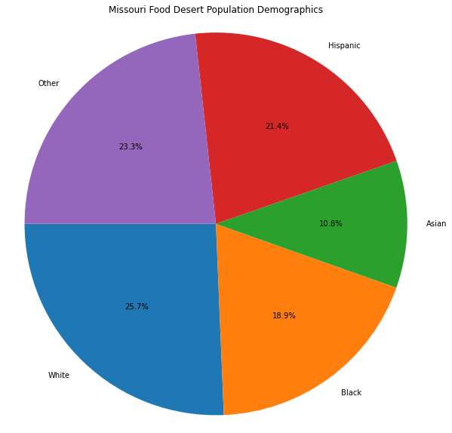
Notes:
MARY

Slide 8
Poverty Rates & Low Access analysis
Notes:
DAVID

Slide 9
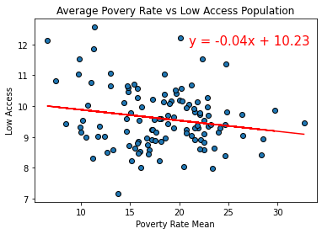

Slide 10
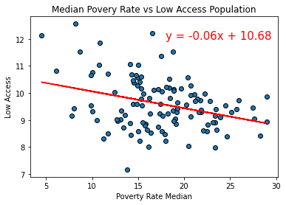

Slide 11
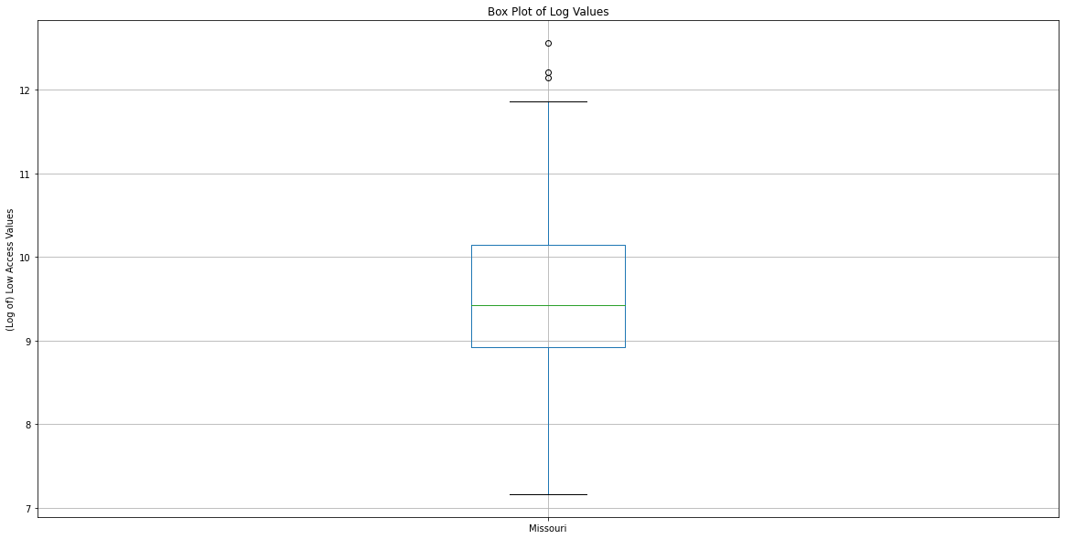

Slide 12
Food environments ANALYSIS
Notes:
JANELLE

Slide 13
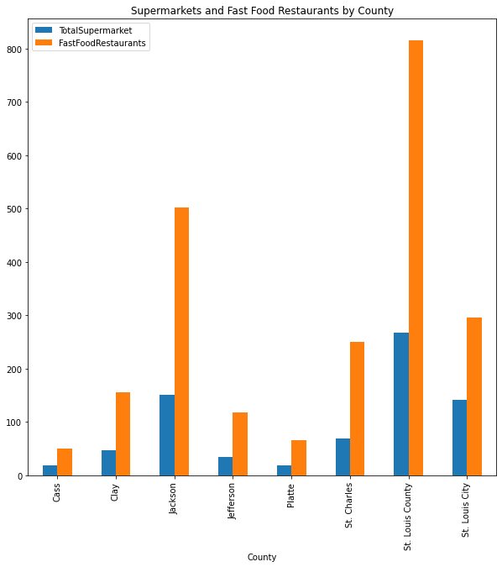
Notes:
JANELLE

Slide 14
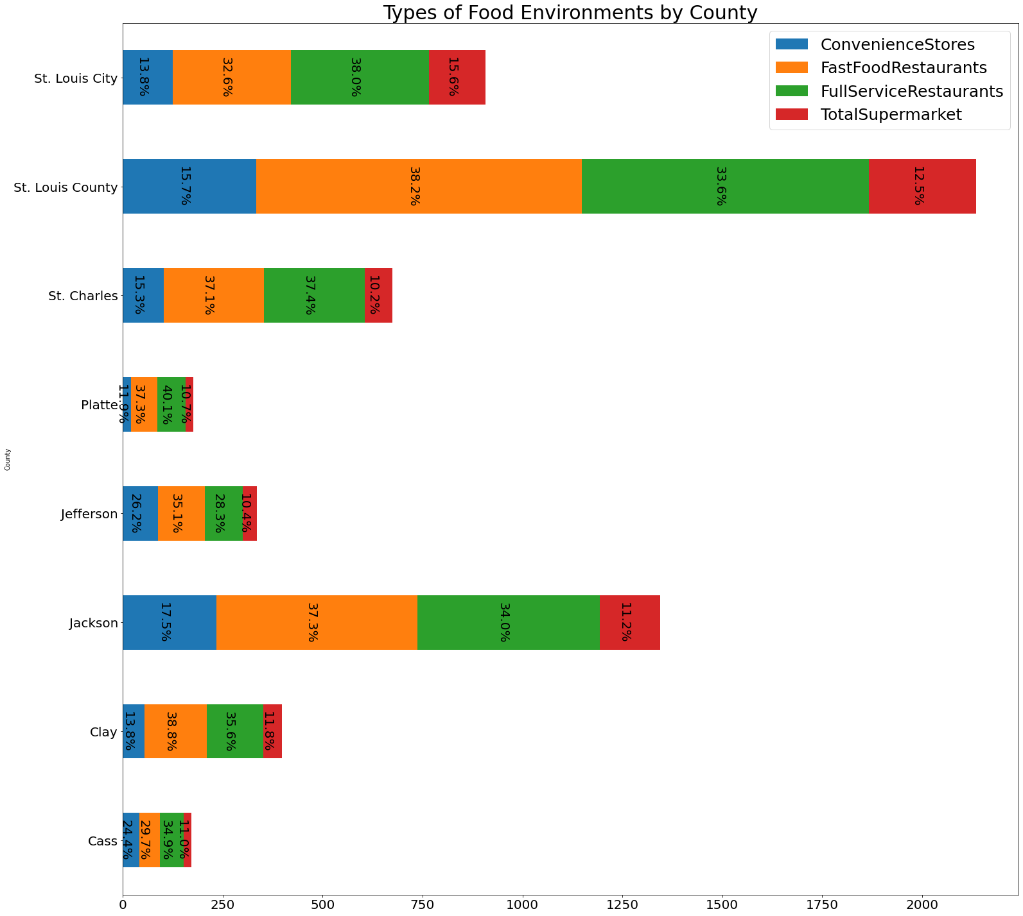
Notes:
JANELLE

Slide 15
Questions?
Notes:
JANELLE

Slide 16
Sources
https://www.ers.usda.gov/data-products/food-access-research-atlas/download-the-data/
https://www.census.gov/topics/income-poverty/poverty/guidance/poverty-measures.html

